Slide 1


Intro TO SQL SESSION 1
Sep 5 18, 2023 – MaY 4th 2023
Week 1: April 28 & APRIL 24th
Instructor: Sylvia Vargas sqlsylvia@Gmail.com
LinkedIn: https://www.linkedin.com/in/sylviavargas/
BLOG: https://sylviavargas.com/
BLOG (In PROGRESS): http://shesatechie.org/
All slides on GitHub: https://github.com/sqlsylvia/GDI-SQL

Slide 2
GDI’s INTRO To SQL
This class will focus on understanding how to use SQL and its basic syntax.
Topics in this course will include: querying and aggregating data in individual tables, querying multiple related tables (JOINs), and writing subqueries.
In this course, online SQL database tools will be used to teach students how to write queries. No installation is required.

Slide 3
Welcome
Girl Develop It is here to provide affordable and accessible programs to learn software through mentorship and hands-on instructions.
Code of Conduct - https://girldevelopit.com/code-of-conduct/
Some Rules:
- We are here for you!
- Every question is important. Ask questions!
- Help each other
- Have fun
Notes:
Welcome

Slide 4
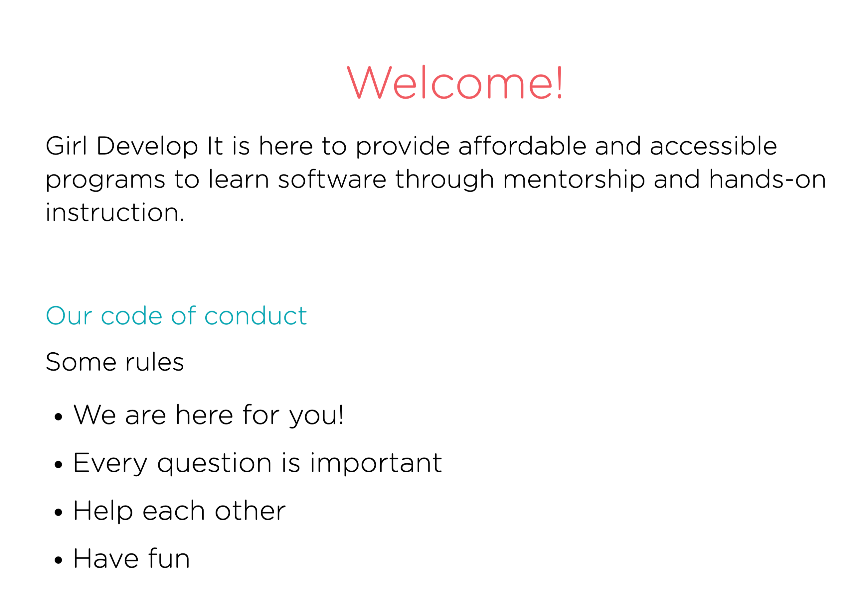
Notes:
Welcome
Girl Develop It is here to provide affordable and accessible programs to learn software through mentorship and hands-on instruction.
Code of Conduct - https://girldevelopit.com/code-of-conduct/
Some Rules:
We are here for you!
Every question is important
Help each other
Have fun

Slide 5
Tell us about Yourself
Who are you?
What’s your experience level with SQL?
What do you hope to get out of the class?
What is your favorite movie and how many times have you watched it?
Notes:
Tell us about Yourself
- Who are you?
- What’s your experience level with SQL?
What do you hope to get out of the class?
What is your favorite movie and how many times have you watched it?
Click on the link below
https://docs.google.com/forms/d/e/1FAIpQLScmzaWMCE1IobYhLQeEfjrwKpfVMdiUCqRYOPv7P_jSKI0v1Q/viewform?usp=sf_link

Slide 6

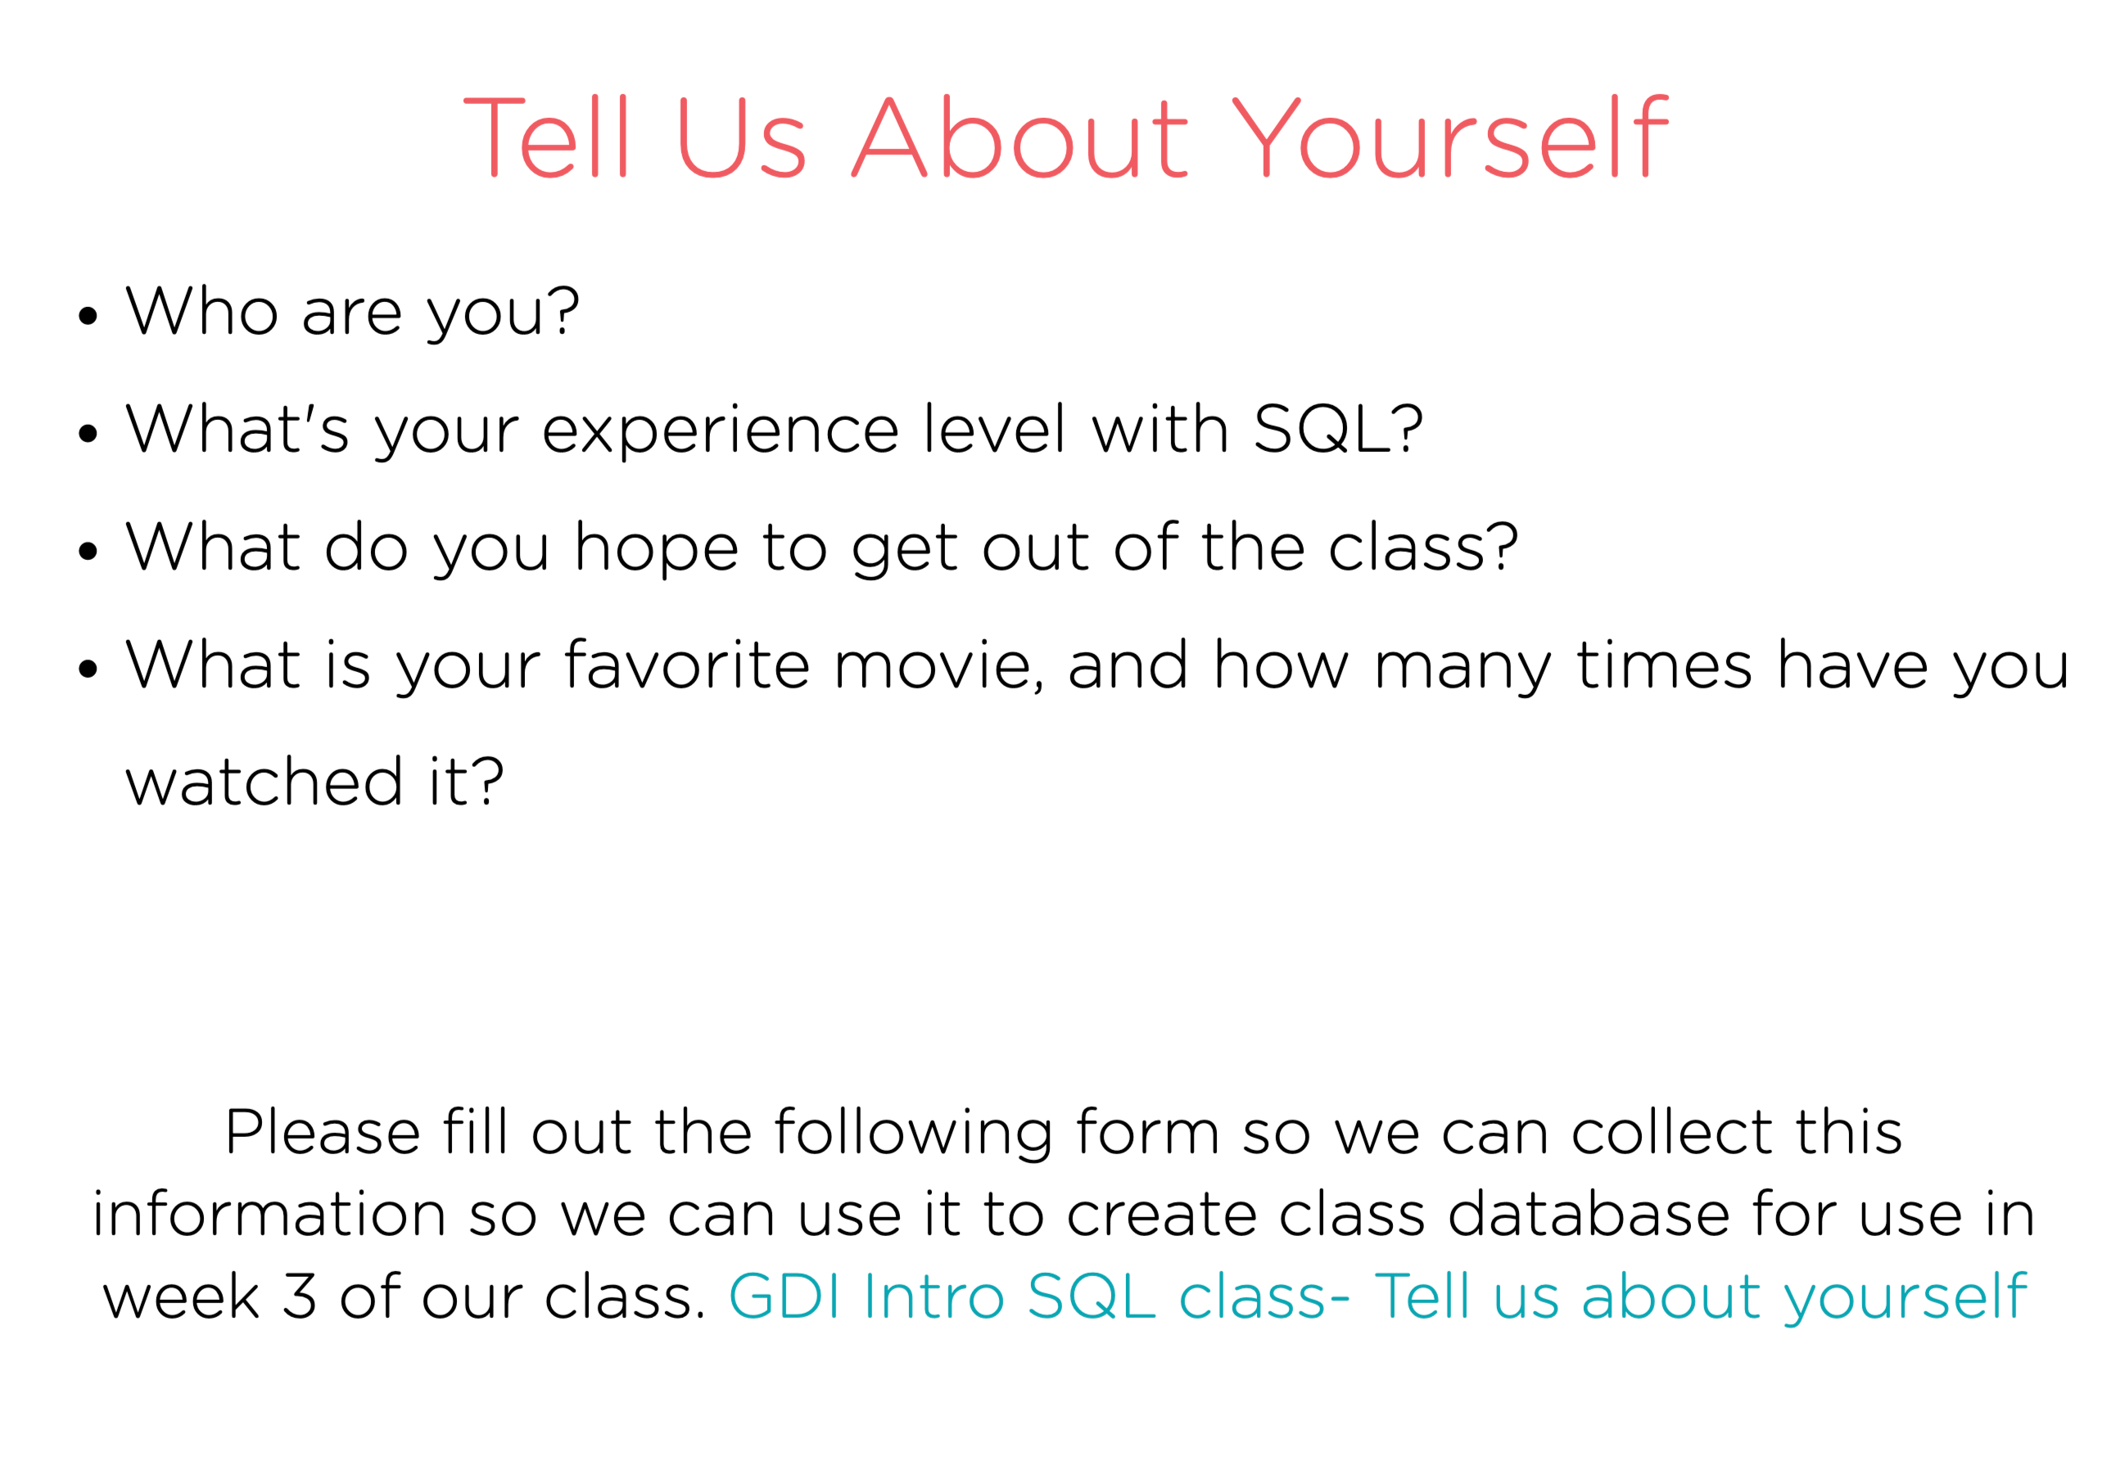
Notes:
Tell us about Yourself
- Who are you?
- What’s your experience level with SQL?
What do you hope to get out of the class?
What is your favorite movie and how many times have you watched it?
Click on the link below
https://docs.google.com/forms/d/e/1FAIpQLScmzaWMCE1IobYhLQeEfjrwKpfVMdiUCqRYOPv7P_jSKI0v1Q/viewform?usp=sf_link

Slide 7
About Me
Checkout my LinkedIn page - https://www.linkedin.com/in/sylviavargas/
Retired as from Microsoft as a Sr Data Scientist
40+ year of experience in Tech and SQL working as a developer, manager, and Data Scientist in a number of companies. Including Disney, Merrill Lynch, Boeing
My favorite movie is a three way tie between West Side Story, Hamilton and Encanto
Notes:
https://www.linkedin.com/in/sylviavargas/
About Me

Slide 8
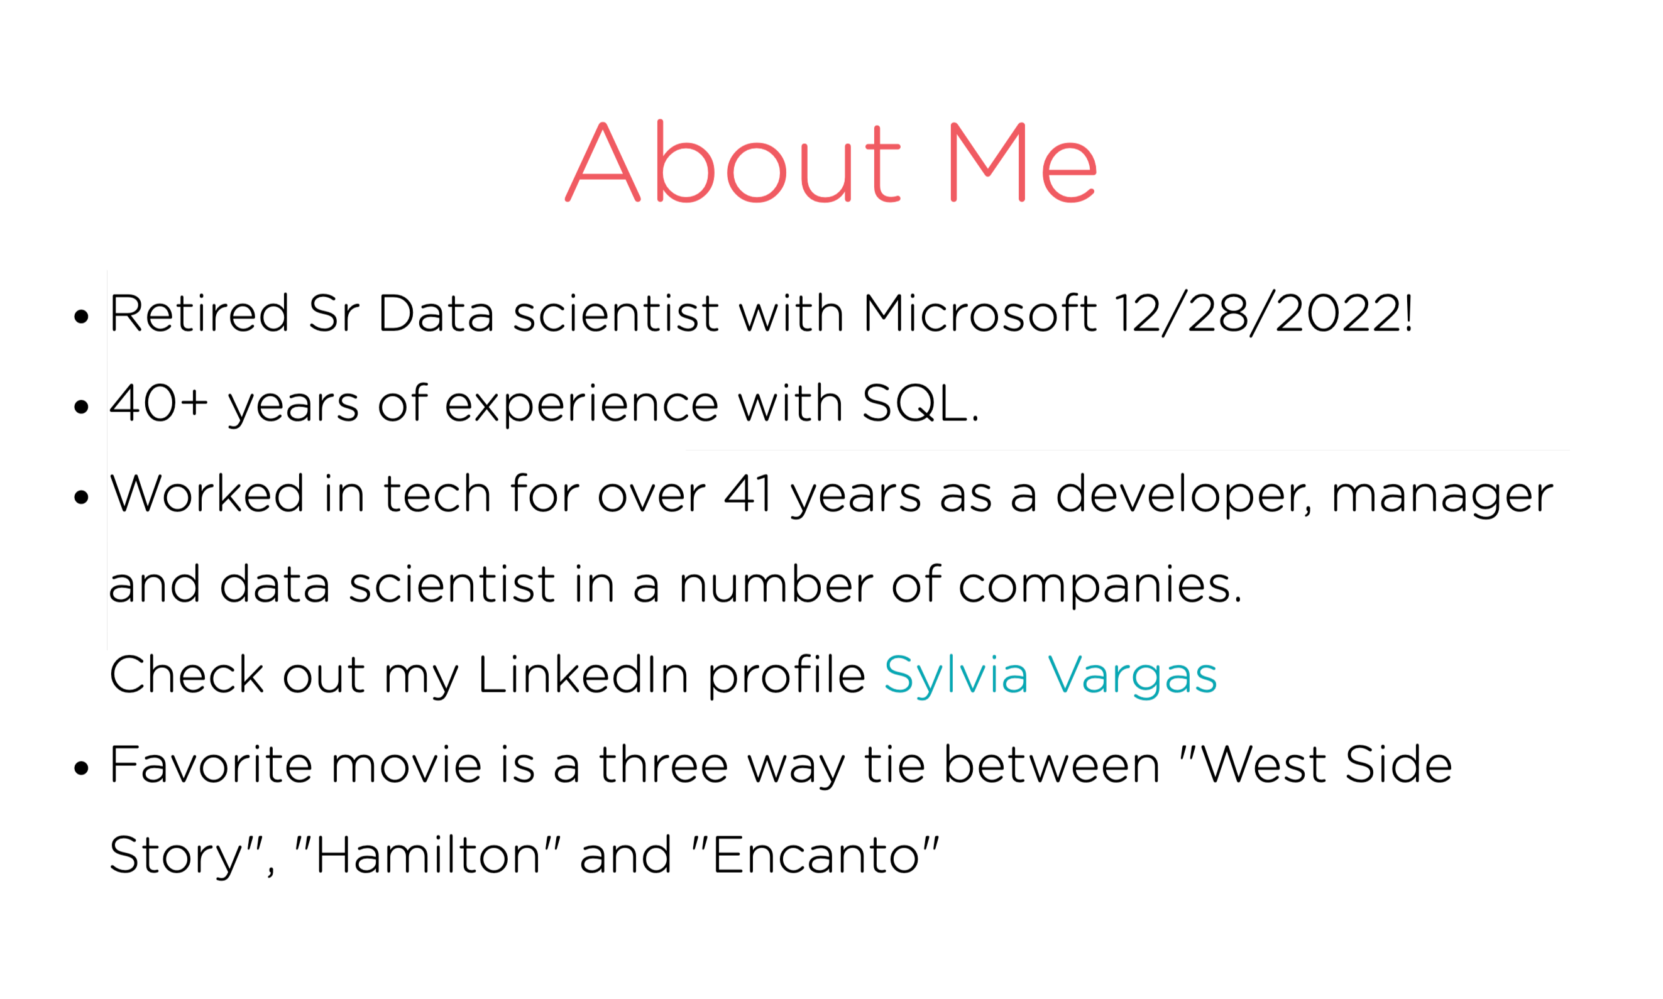
Notes:
https://www.linkedin.com/in/sylviavargas/
About Me
- Retired as from Microsoft as a Sr Data Scientist
- 40+ year of experience in Tech and SQL working as a developer, manager, and Data Scientist in a number of companies.
My favorite movie is a three way tie between West Side Story, Hamilton and Encanto

Slide 9
Class OUTCOMES
As a compliment to the Database Design Class, you will learn the same terminology as the Database Design Class.
You will have hands-on experience and support.
By the end of the class, you will be able to query and modify data as well as tables.

Slide 10
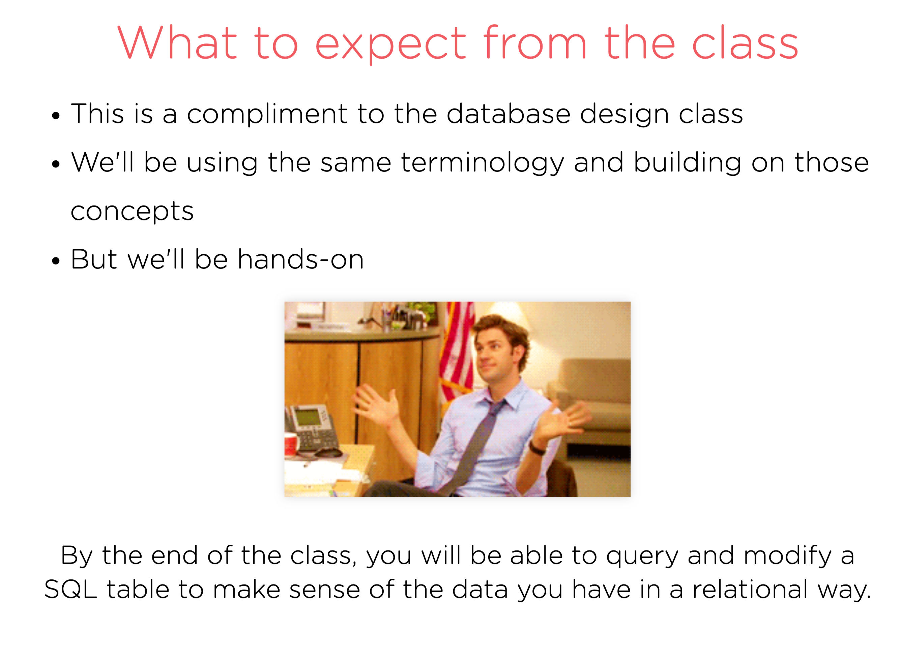

Slide 11
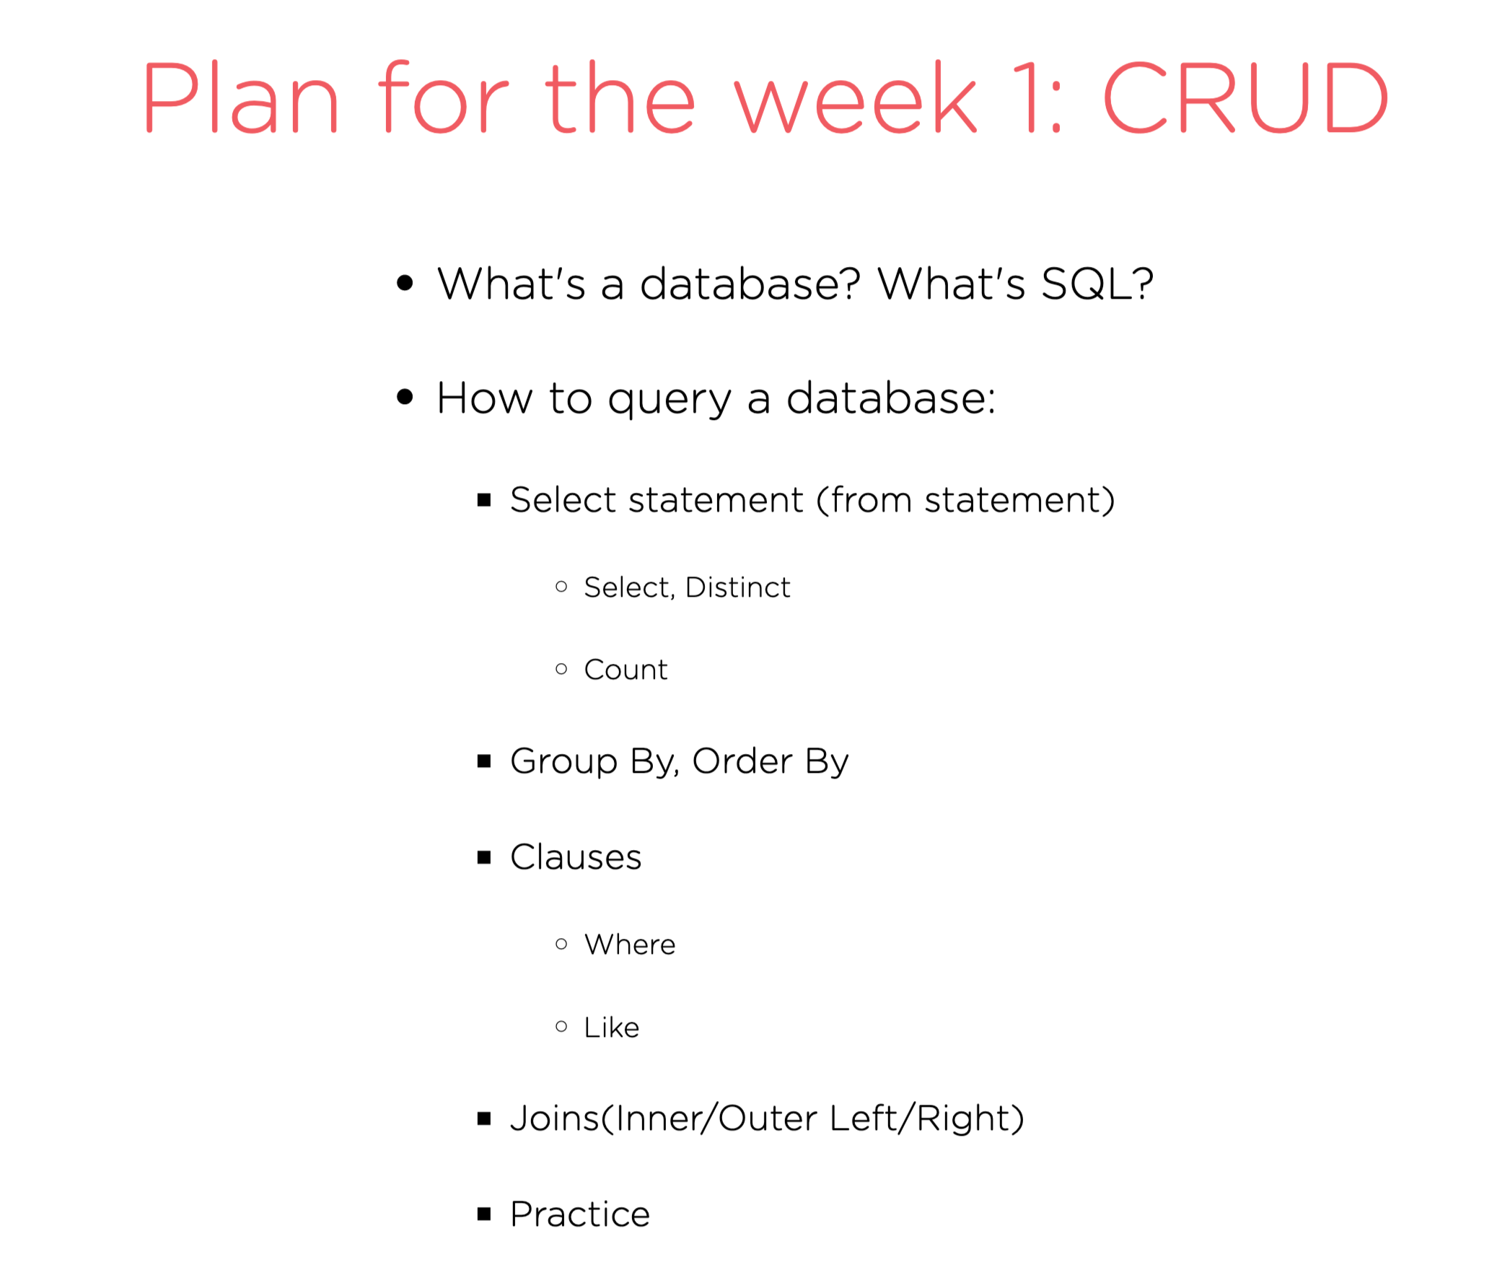

Slide 12
Plan for Week 2
- What’s a database? What is SQL?
- Basics of how to query a database?
1. BASIC SELECT Statement
SELECT and FROM commands
COUNT command
2. ORDER BY clause
3. WHERE clause
4. LIKE clause
5. GROUP BY and HAVING
4. JOINS – Inner, Left and Right outer joins
PRACTICE

Slide 13
Plan for Week 2
Subqueries
How to modify a database?
Creating a table
PRACTICE
Inserting and Updating data in a table
Deleting Rows versus Deleting Tables
Optimize Queries

Slide 14
Plan for Week 3
Special Projects
New database
More Practice and Mentoring
GDI Survey

Slide 15
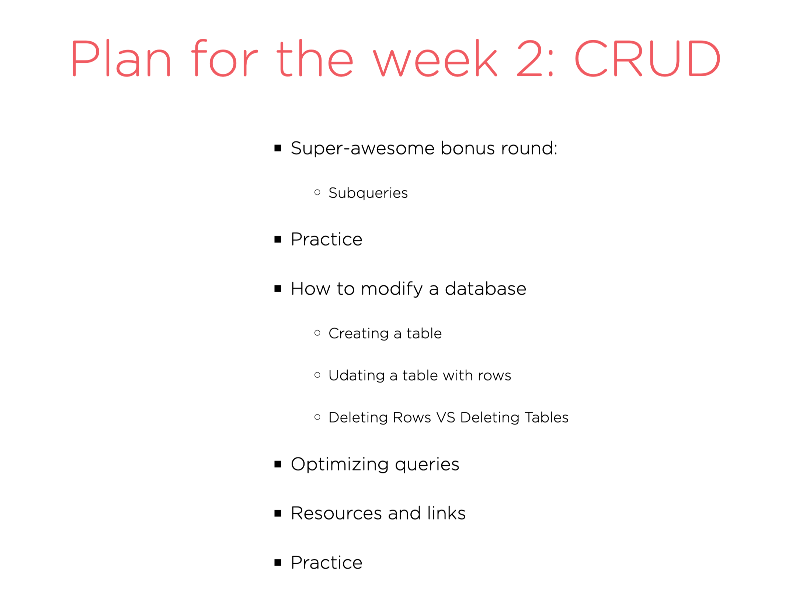
Notes:
Subqueries
Practice, Practice, Practice
How to Modify a Database
- Creating a table
- Inserting and Updating data in a table
- Deleting Rows versus Deleting Tables
Optimizing queries
Practice

Slide 16


Slide 17
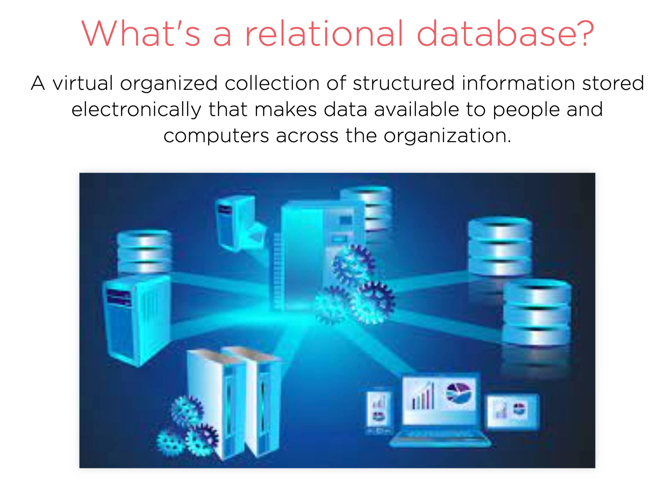

Slide 18
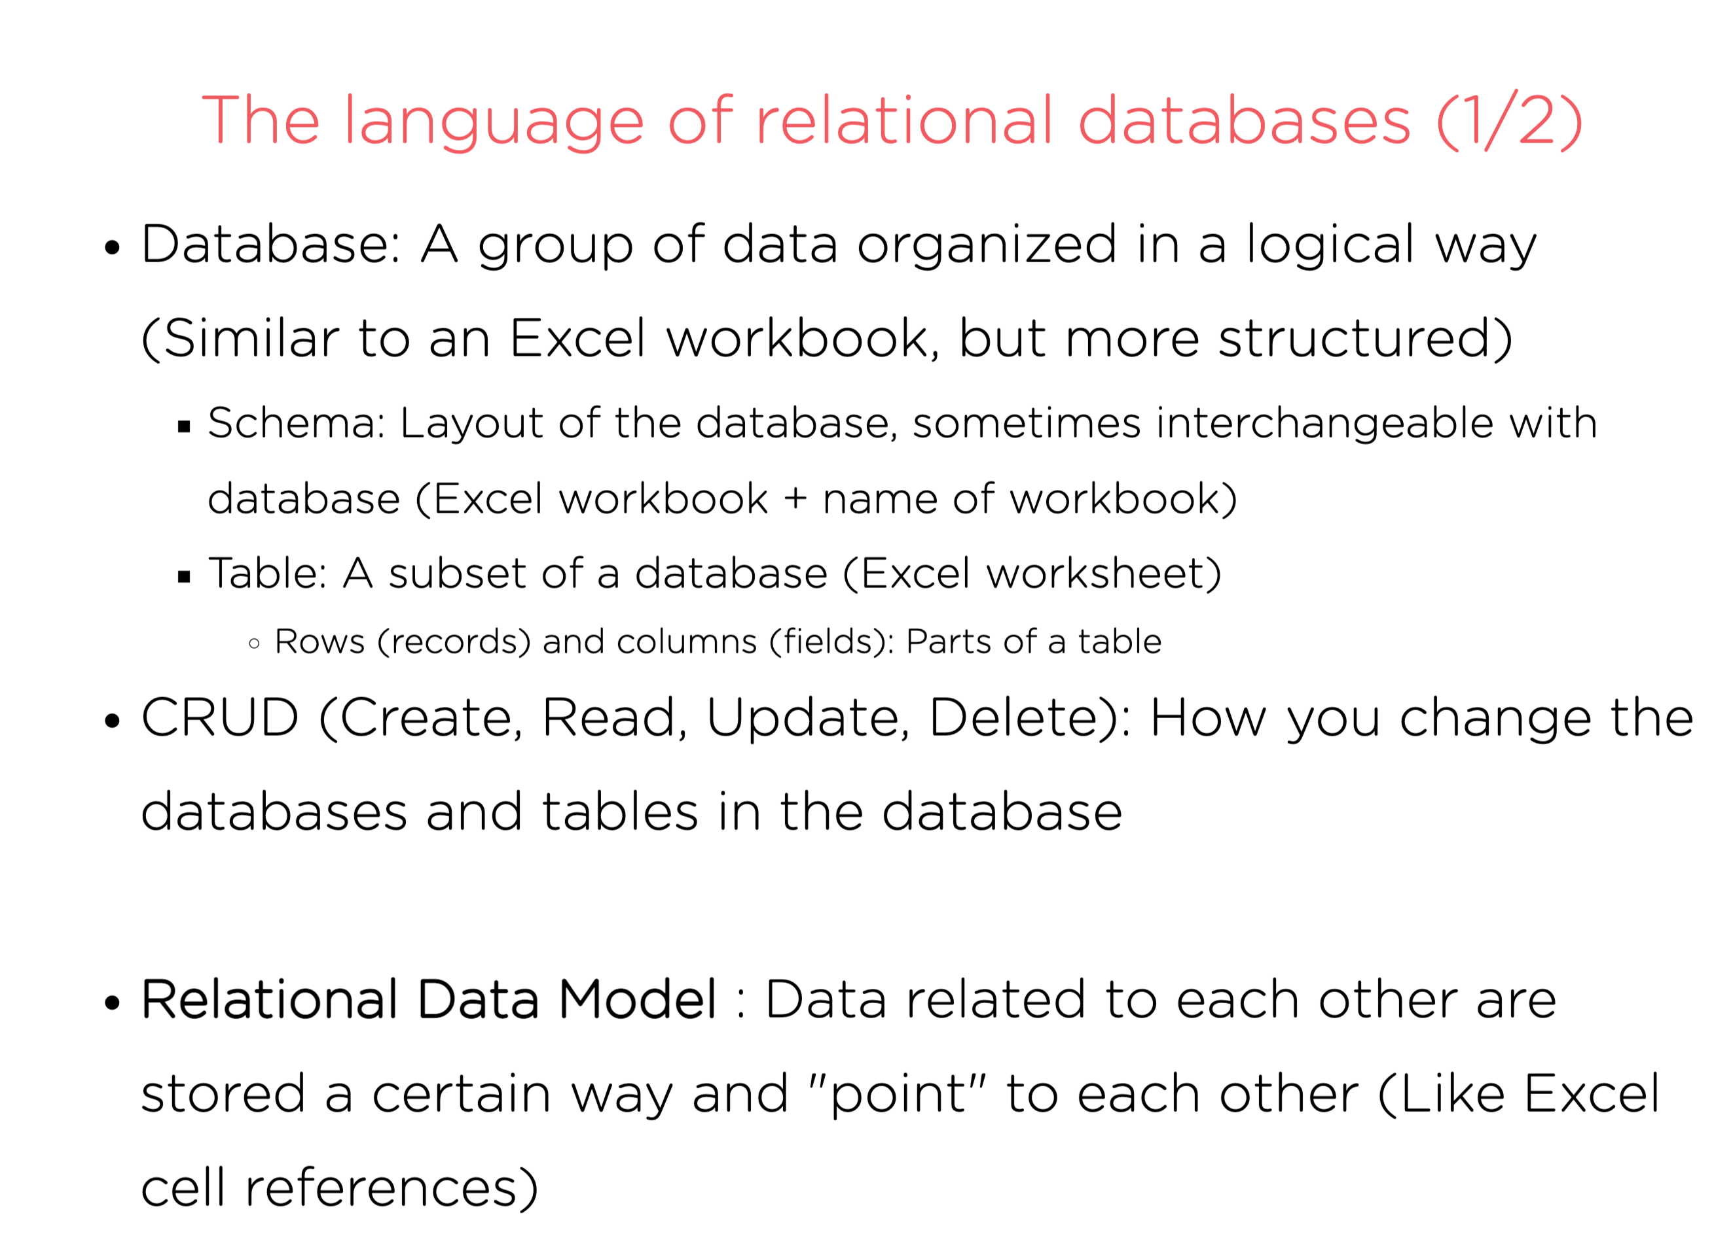
Notes:
Database

Slide 19
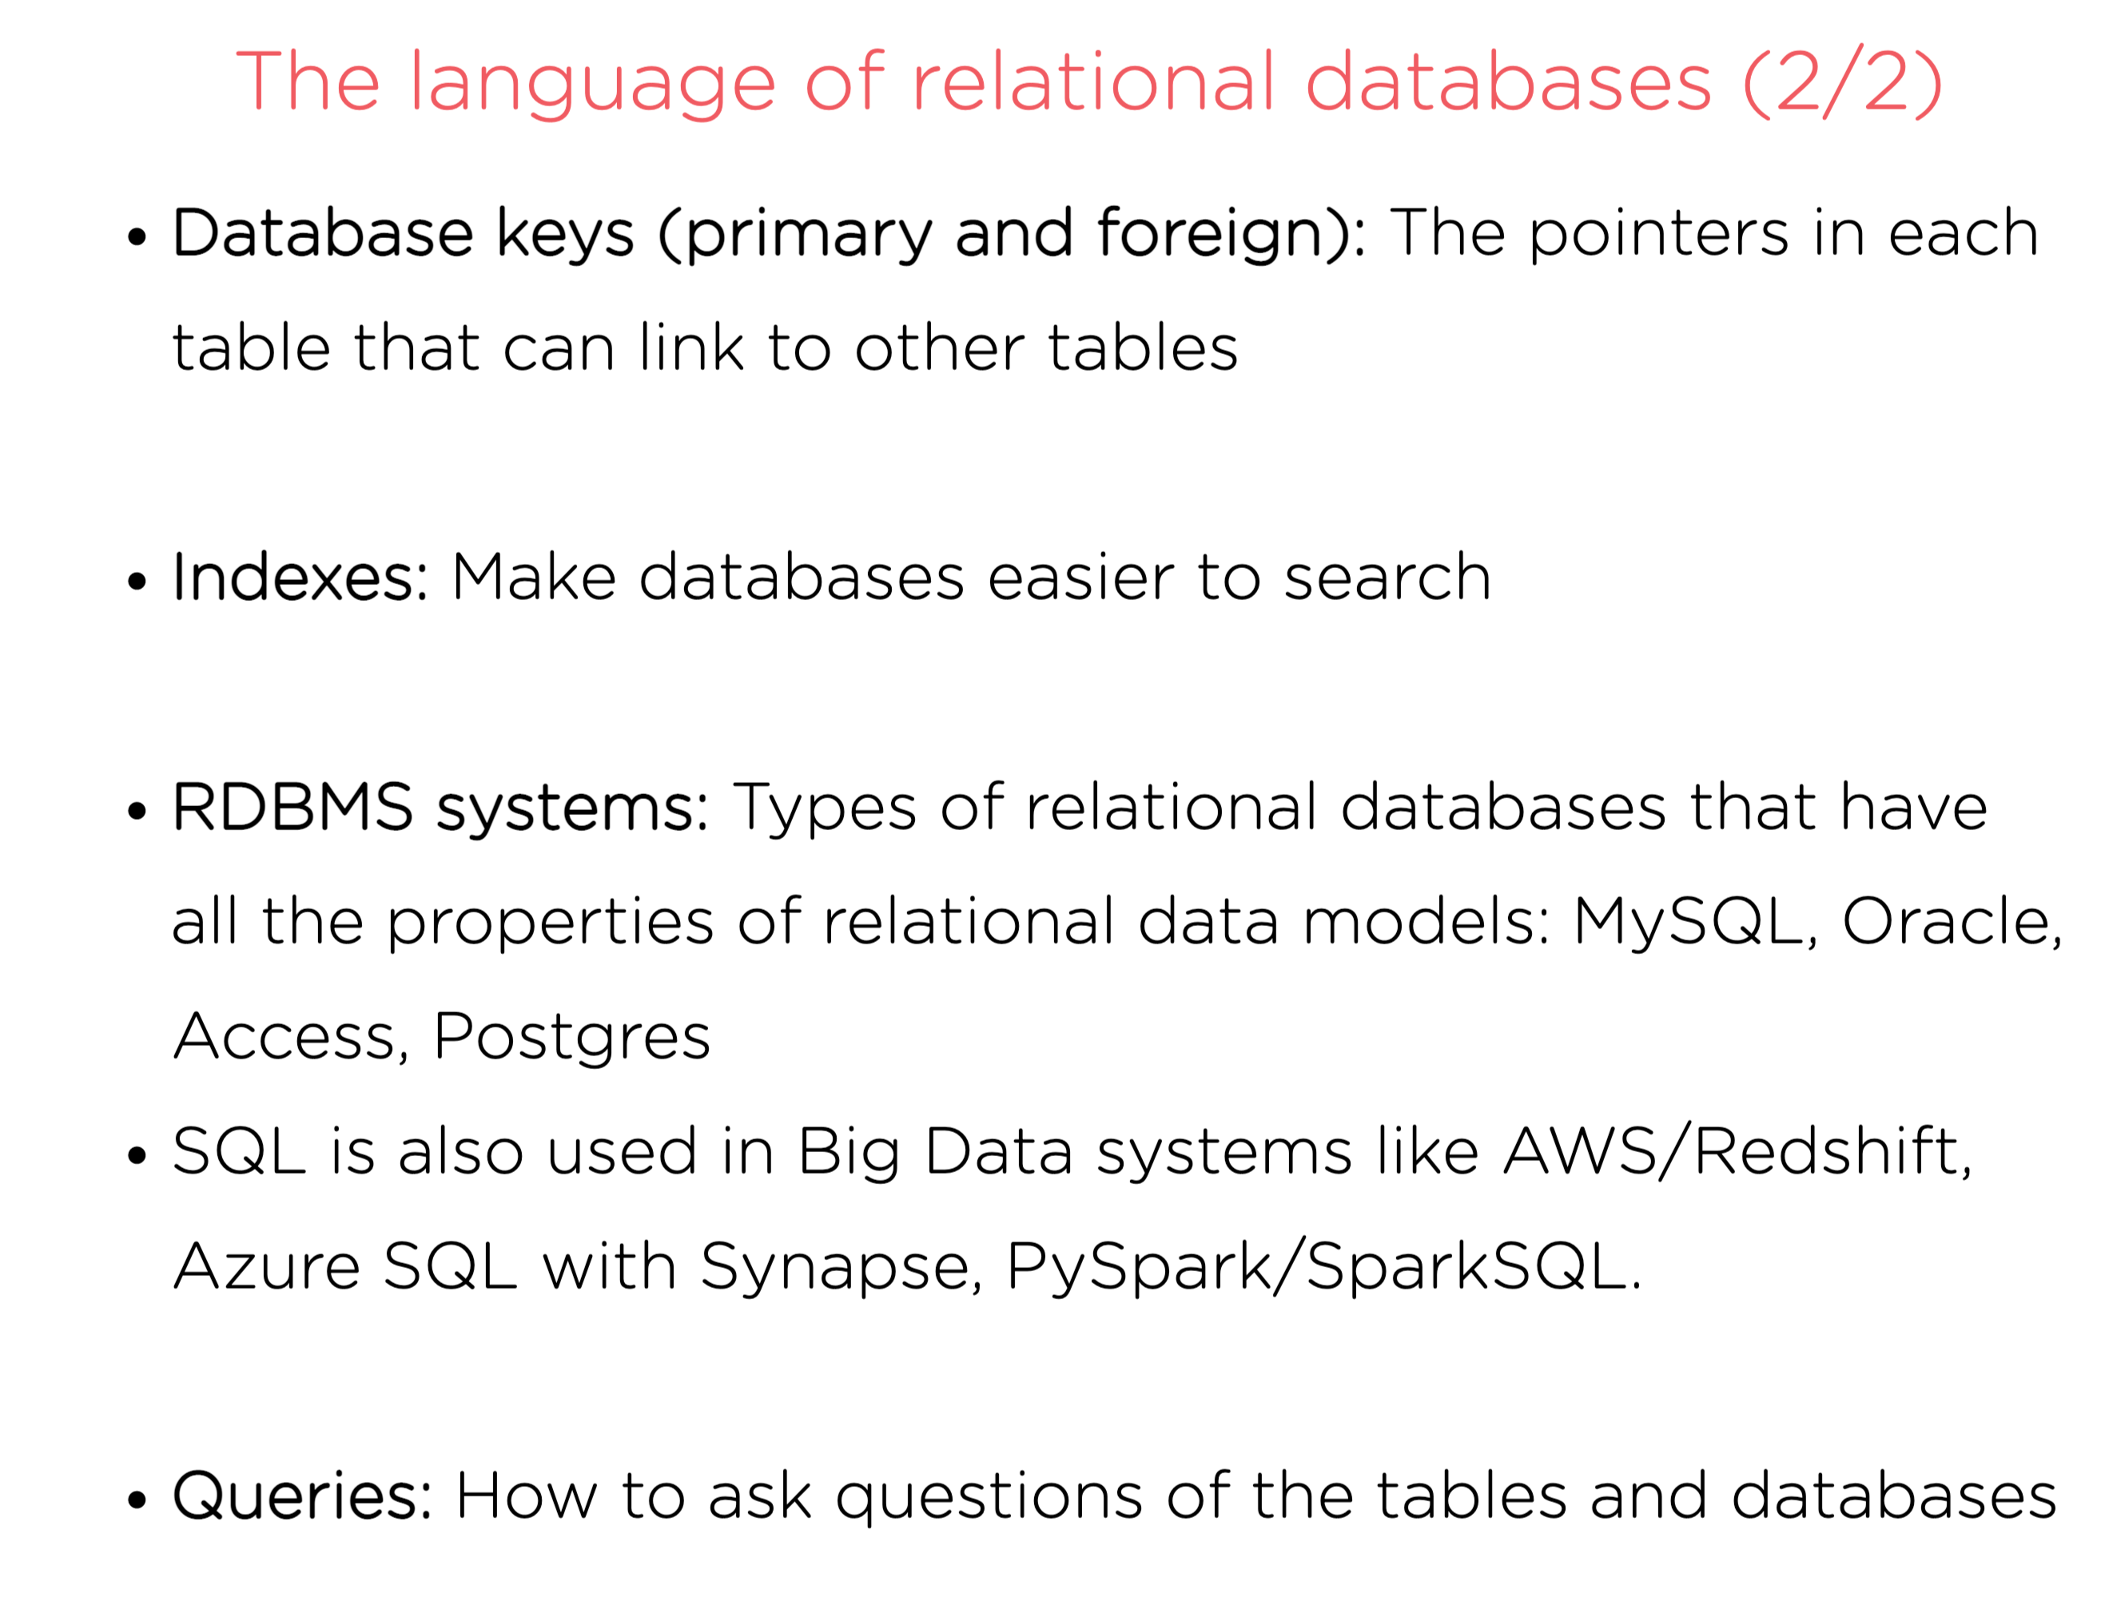

Slide 20
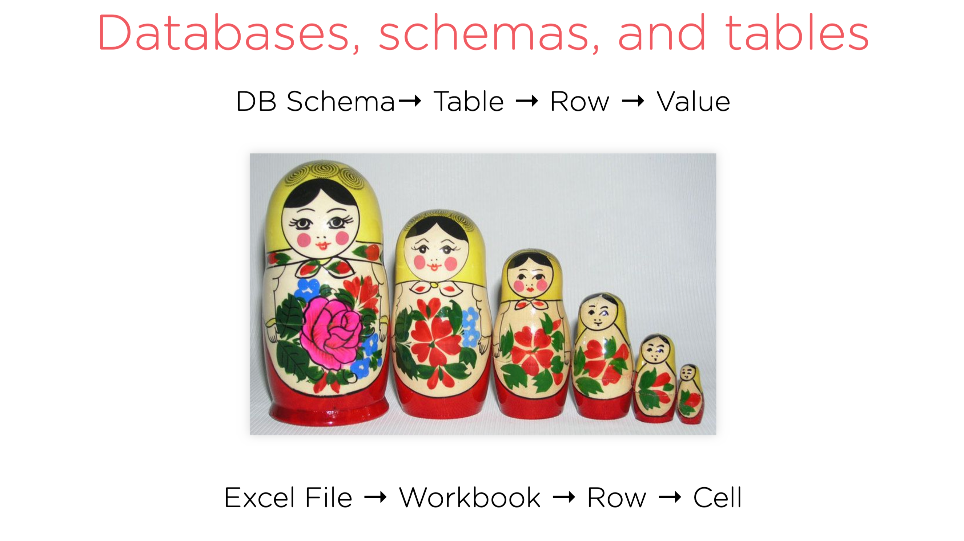
Notes:
A database schema is the blueprint/ map of how your data looks like.
Example database with schema: https://www.db-fiddle.com/f/saNqcpC8NgN5LbDdRiyD49/1

Slide 21
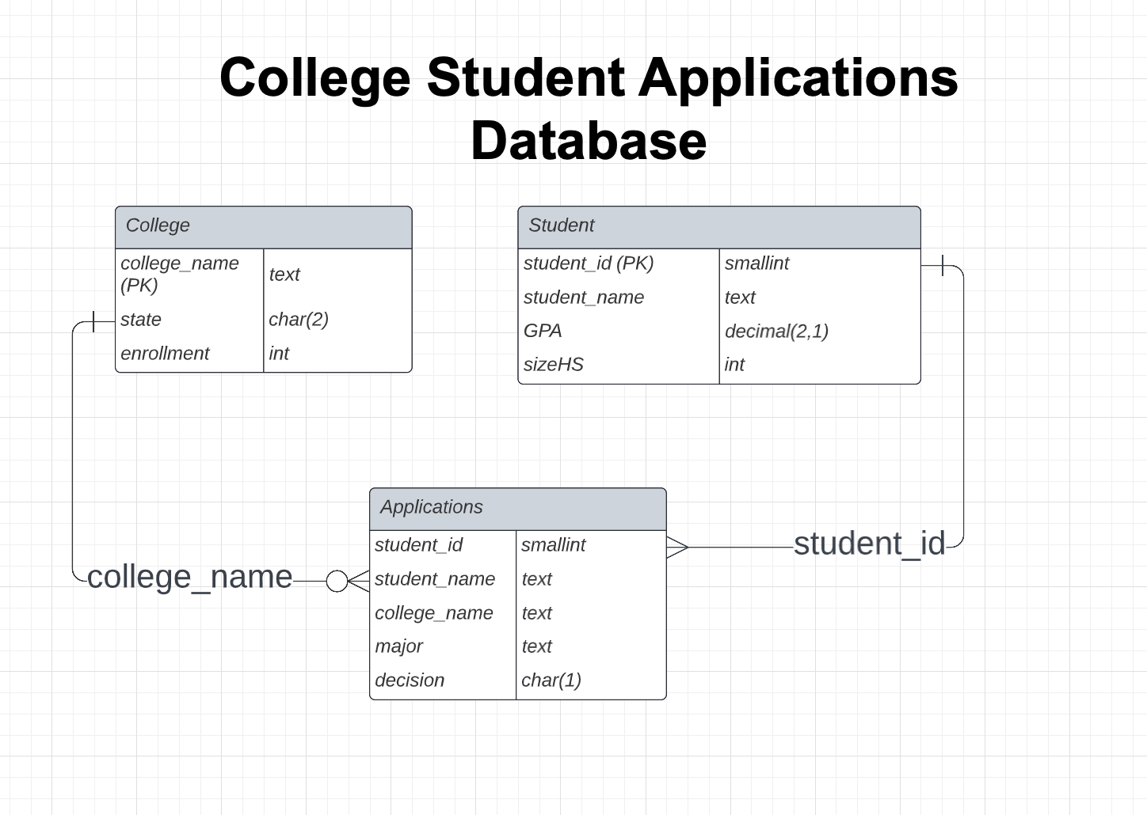
What’s a Relational DATABASE
Excel spreadsheets you can join without Vlookups? NO!
A relational database is a type of database that stores and provides access to data points that are related to one another.
Relational databases are based on the relational model, an intuitive, straightforward way of representing data in tables. In a relational database, each row in the table is a record with a unique ID called the key.

Slide 22






Different Flavors of SQL
How do you say that you want a can of Coca-Cola? Coke, soda or pop?
How do you write SQL?
Every SQL query starts with a SELECT statement.
But every SQL database vendor has a different "enhancements".
All different flavors of the same language

Slide 23
What’s SQL
It's the language that the database speaks to bring you back data
Has a lot of words similar to English, but they have their own meaning as keywords.
SELECT user_name, SUM(total_purchases)
FROM billing_database.user_table
WHERE user_name LIKE 'Henderson%’
AND billing_month = 'January'
GROUP BY user_name;

Slide 24
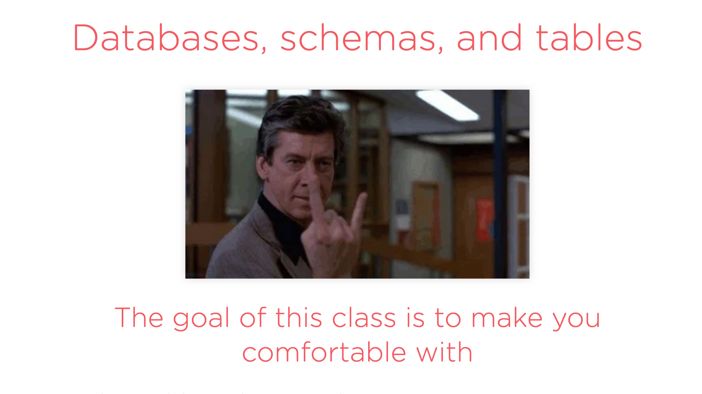

Slide 25
DataBASE and CRUD
In the 1980s as relational databases were being created, the acronym CRUD was developed to define 4 basic operations.
Create: INSERT, CREATE Commands to create a table and add data of rows to a table.
Read: SELECT Picking specific information from your table
Update: UPDATE, ALTER Changing specific information in your table
Delete: DELETE, DROP, TRUNCATE Command to remove tables and/or data from the database.

Slide 26
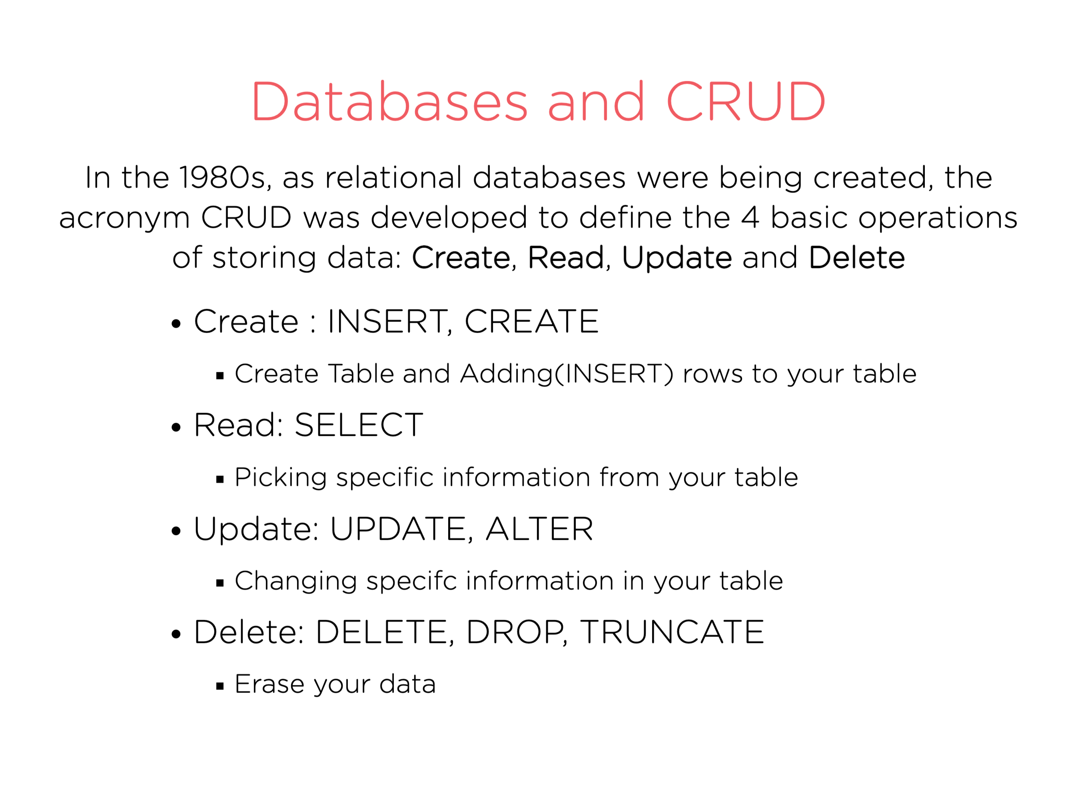

Slide 27
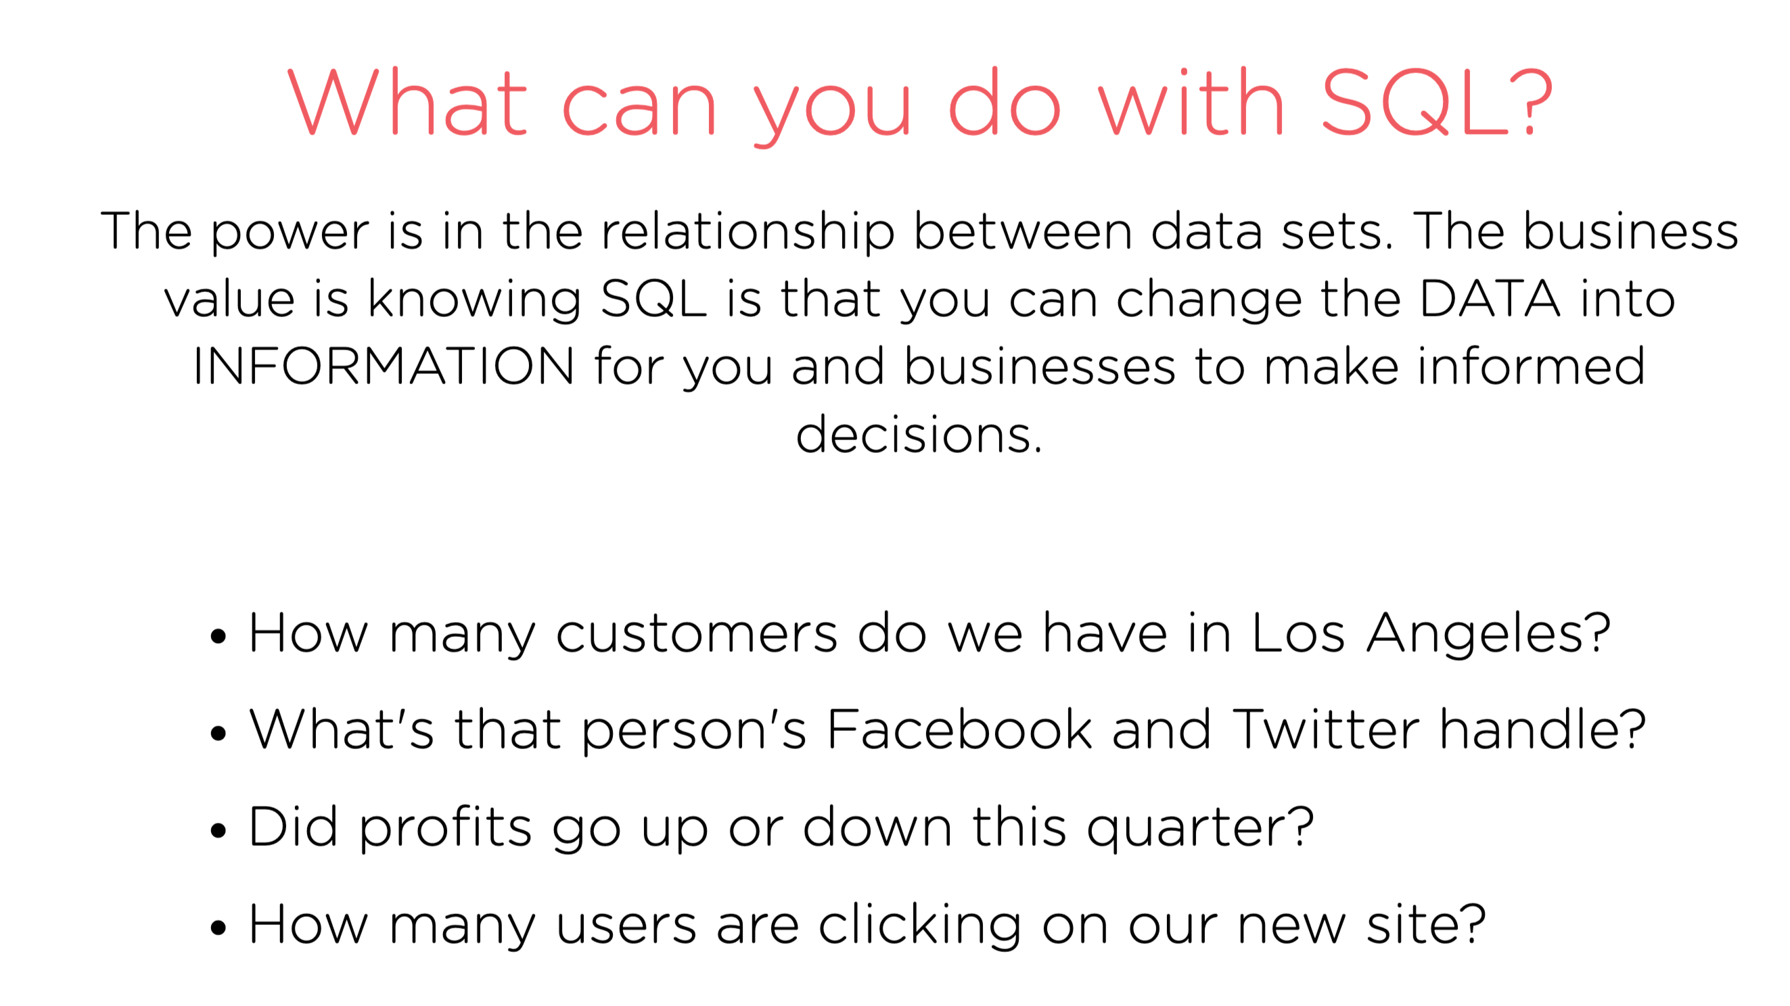

Slide 28
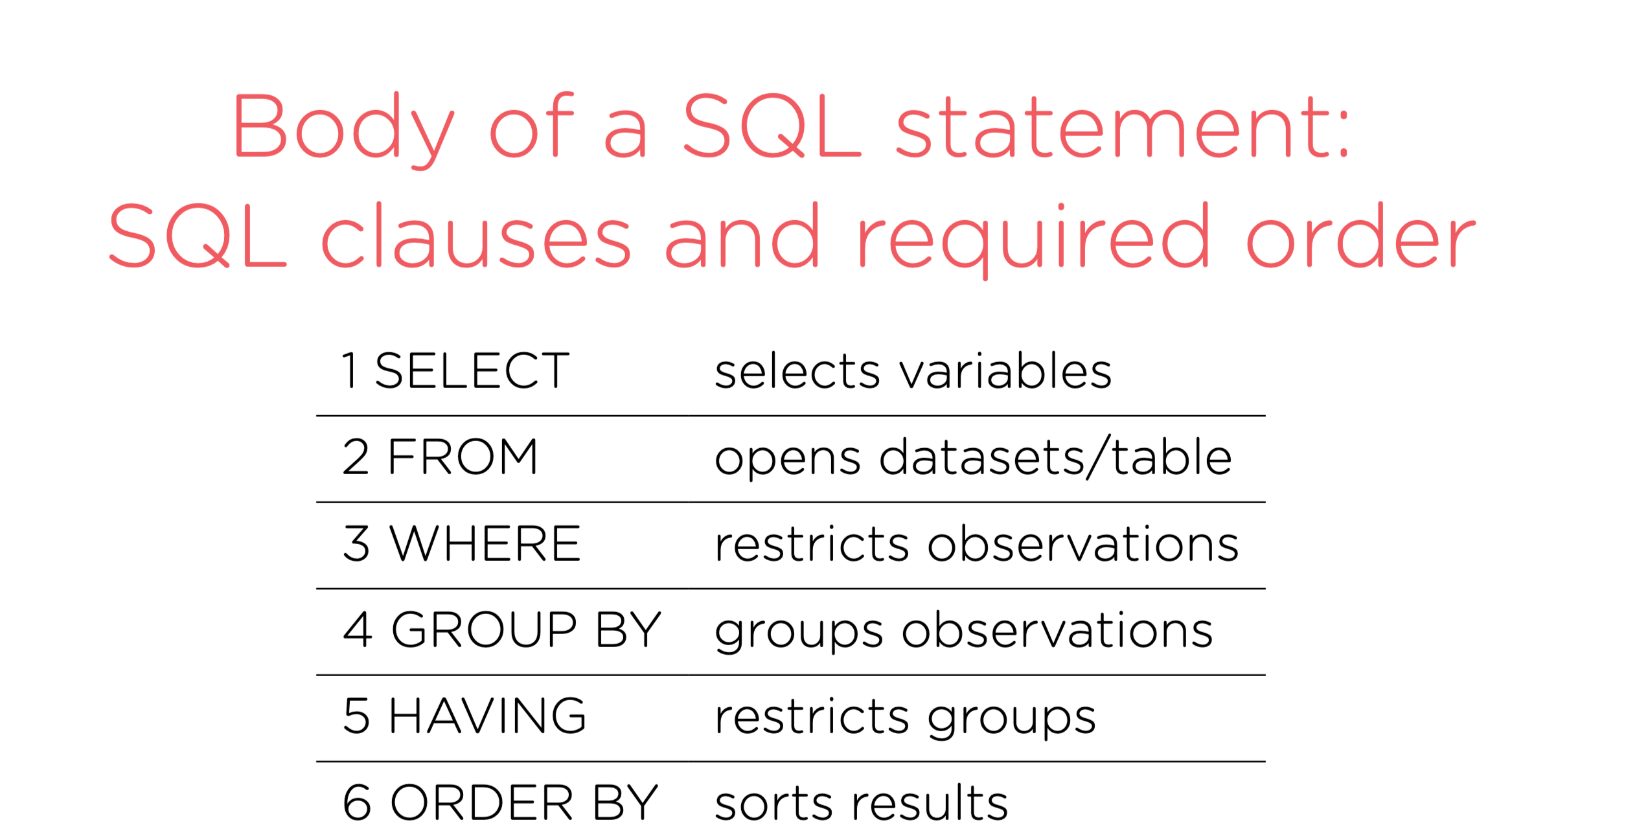

Slide 29


Slide 30
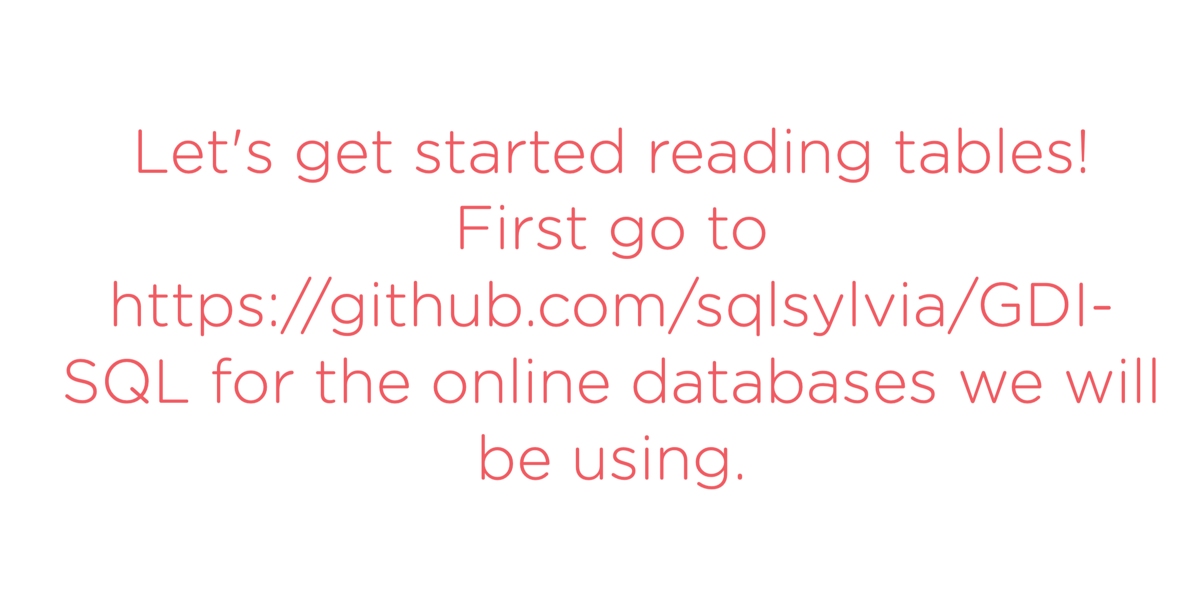
Notes:
https://github.com/sqlsylvia/GDI-SQL

Slide 31
Let’s Start!
Go to https://github.com/sqlsylvia/GDI-SQL

Slide 32


Slide 33
Online SQL Tools
W3Schools has a SQL database to query - https://www.w3schools.com/sql/trysql.asp?filename=trysql_editor
DB Fiddle is a site used by companies to assess SQL skills, but it is also an easy way to learning to using SQL as well as create tables. https://www.db-fiddle.com/f/6eXpPSRFQgzdKUCjSsbSF4/9
REPLIT.com is another way to learn SQL using SQLLite. I have created some examples for you to learn with. https://replit.com/@sqlSylvia/GDI-SQLIntro

Slide 34
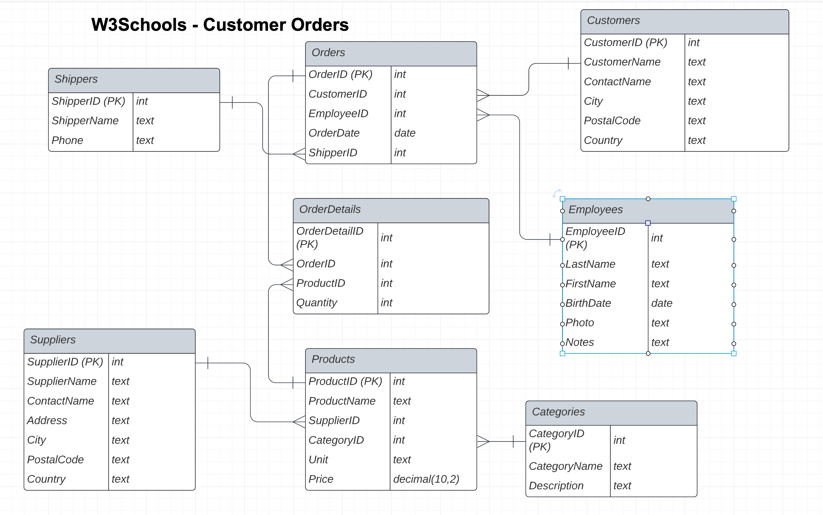
W3 ScHOOLS – Data BASE
In your browser open the following url to work with a SQL database in W3Schools.
https://www.w3schools.com/sql/trysql.asp?filename=trysql_editor
Notes:
https://www.w3schools.com/sql/trysql.asp?filename=trysql_editor

Slide 35
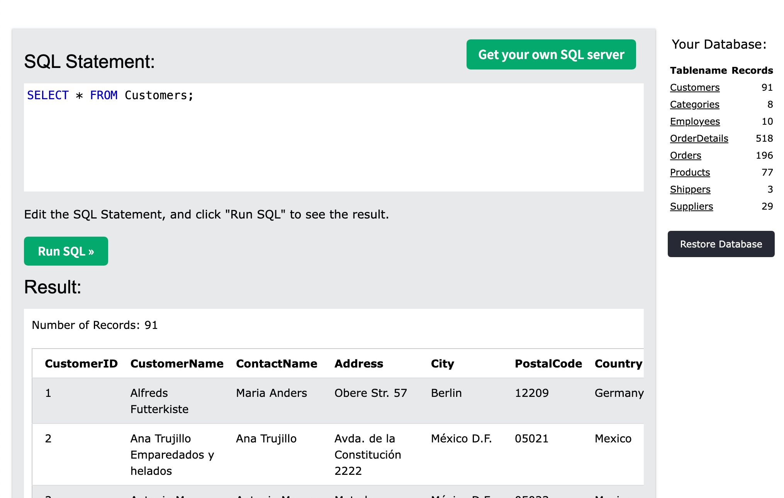
SELECT * FROM <Table>
SELECT statement is used to select data from a database.
The FROM command is used to specify which table to select data from.
* is used to return all columns of data in the table.
The absence of a WHERE command means return all rows.

Slide 36
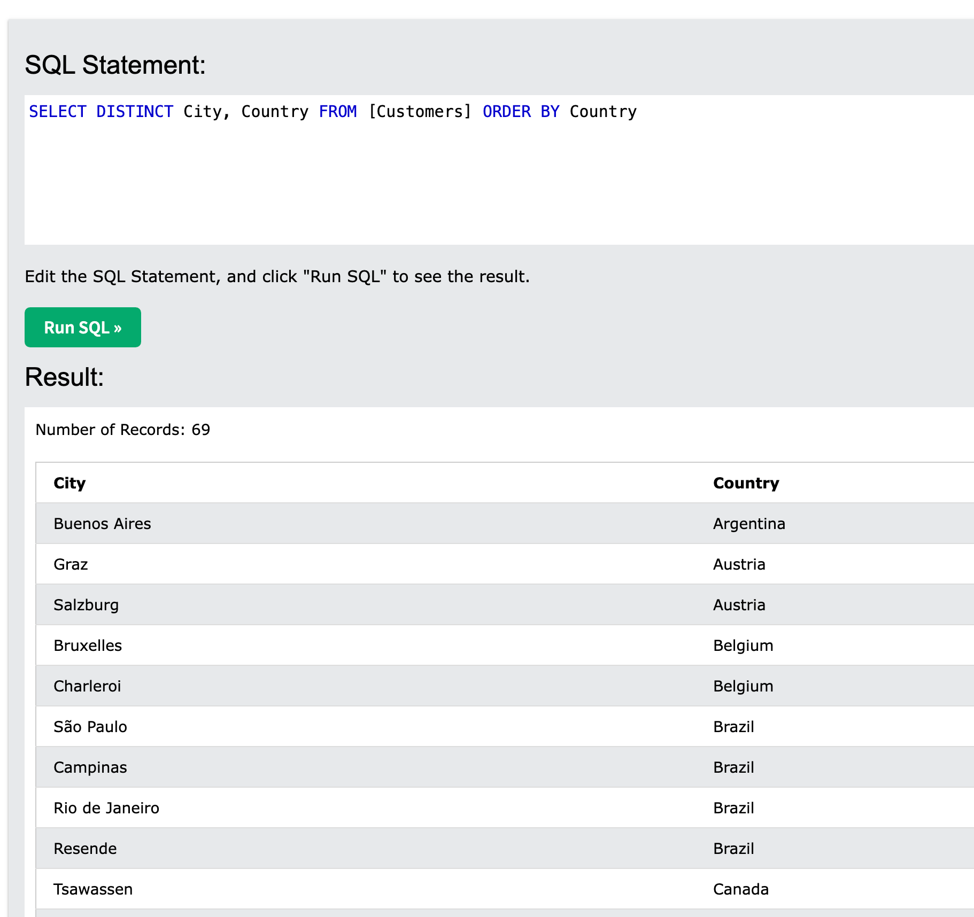
SELECT DISTINCT and ORDER BY
The DISTINCT clause returns only UNIQUE records (removes duplicate records).
ORDER BY sorts the results in alphabetical or numeric order depending on table fields/columns in the SELECT statement
Try the following
SELECT DISTINCT City, Country FROM [Customers] ORDER BY COUNTRY

Slide 37
SQL Aggregate FUNCTIONS
SQL function | returns
AVG() | the mean average of the elements in the column
COUNT() | the total number of elements in the column
DISTINCT() | the number of distinct values across the column
MAX() | the largest-value element in the column
MIN() | the smallest-value element in the column
SUM() | the arithmetic total of all values in the column
TRY the following in Customer Orders Database
SELECT MAX(OrderDate) , COUNT(*) FROM [Orders]
SELECT MIN(Price), MAX(Price) , AVG(PRICE) FROM [Products]
SELECT DISTINCT Country FROM [Customers]
Notes:
https://www.udacity.com/blog/2021/04/sql-aggregate-functions-avg-count-distinct-max-min-sum.html

Slide 38
Using the Where Clause
The WHERE clause is used to returns the rows meeting the criteria
Try the following and let’s discuss your results
SELECT * from Suppliers WHERE Country = "USA”
SELECT * FROM [Customers] where City = "London”
SELECT * FROM [Products] Where Price >= 18
SELECT * FROM [OrderDetails] where Quantity < 5
Notes:
SELECT * FROM [Employees] WHERE Birthdate > "1960-01-01"

Slide 39
SQL OperatORs: AND, OR, NOT
SQL Operators are used within the WHERE Statement and CASE Statement.
Let’s focus on WHERE Statement
SELECT * FROM Customers WHERE Country = "Argentina" OR Country = "Venezuela”
SELECT * FROM Customers WHERE Country = "Venezuela" AND PostalCode = 5022
Notes:
https://www.w3schools.com/sql/sql_and_or.asp
https://www.w3schools.com/sql/sql_case.asp

Slide 40
LIKE Clause
The LIKE operator is used in a WHERE clause to search for a specified pattern in a column.
There are two wildcards often used in conjunction with the LIKE operator:
The percent sign (%) represents zero, one, or multiple characters
The underscore sign (_) represents one, single character
Notes:
https://www.w3schools.com/sql/sql_like.asp

Slide 41
JOIN – Joining TABLES
A JOIN combines columns from one or more tables to a new table.
INNER JOIN – returns each row in the two joined tables that have matching column values
LEFT OUTER JOIN - The result of a left outer join (or simply left join) for tables A and B always contains all rows of the "left" table (A), even if the join-condition does not find any matching row in the "right" table (B).
RIGHT OUTER JOIN - A right outer join (or right join) closely resembles a left outer join, except with the treatment of the tables reversed.
FULL OUTER JOIN - combines the effect of applying both left and right outer joins. Where rows in the FULL OUTER JOINed tables do not match, the result set will have NULL values for every column of the table that lacks a matching row. For those rows that do match, a single row will be produced in the result set (containing columns populated from both tables).
CROSS JOIN – returns the Cartesian product of rows from tables in the join. In other words, it will produce rows that combine each row from the first table with each row from the second table.
Notes:
https://en.wikipedia.org/wiki/Join_(SQL)

Slide 42
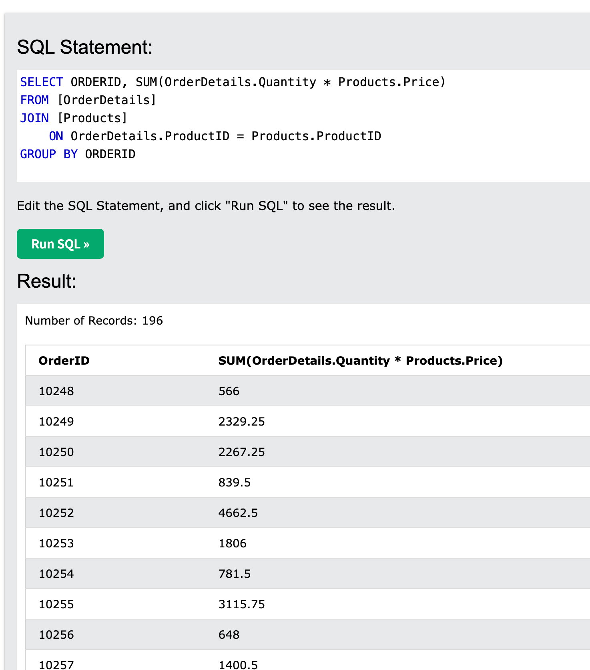
INNER JOIN Example
SELECT ORDERID , SUM(OrderDetails.Quantity * Products.Price ) FROM [OrderDetails] JOIN [Products] ON OrderDetails.ProductID = Products.ProductID GROUP BY ORDERID

Slide 43
JOINS: OUTER LEFT/RIGHT
SELECT Customers.CustomerName, count(Orders.OrderID)
FROM [Customers]
LEFT JOIN [Orders] ON Orders.CustomerID = Customers.CustomerID
GROUP BY Customers.CustomerName
ACTION: Re-write this statement using RIGHT JOIN

Slide 44
Week 1: PractICE Assignment
Using the W3Schools Database answer the following questions:
Which customer has the most number of Orders?
Which customer has spent the most money in Orders?
Are there any employees that went to Boston College? Who?
How many products are there by category? List out CategoryName, and number of products?
How many orders used “Speedy Express” Shipper?
What other insights can you provide?
Notes:
1. SELECT Customers.CustomerName, count(Orders.OrderID)
FROM [Customers]
LEFT JOIN [Orders] ON Orders.CustomerID = Customers.CustomerID
GROUP BY Customers.CustomerName
3. SELECT * FROM [Employees] where Notes like '%Boston College%'

Slide 45
Learning Ang PRACTICING: SQL RESOURCES
Online Databases for learning
https://www.w3schools.com/sql/trysql.asp?filename=trysql_editor
The following 2 databases are the same schema, but in.
https://www.db-fiddle.com/f/6eXpPSRFQgzdKUCjSsbSF4/9 – No login required but you need to save you work elsewhere for backup.
https://replit.com/@sqlSylvia/GDI-SQLIntro. - replit you need an account to save your work
SQL Reference information
https://www.w3schools.com/sql/default.asp
https://www.tutorialspoint.com/sql/index.htm

